Slide 1
WASH in Mozambican Schools and Climate Resilience: Understanding the Policy Gap
Jemima Dale
MA Conflict, Development and Security | BSc Geography
Notes:
Bom Dia, my name is Jemima and I am the postgraduate student who has been conducting this research in partnership with WaterAid. The following presentation should last approximately 30 minutes, and I will be happy to answer any questions at the end.

Slide 2
Context
Access to safe water, sanitation, and hygiene (WASH) is pivotal for safe, quality education and sustainable development.
Addressing WASH successfully in schools reaches a large amount of the population – at school and at home.
WASH in schools is only safe for all if age, gender, and disability are adapted to.
Climate resilient WASH -> sustainably safe WASH.
Climate resilient WASH -> climate resilient people.
Notes:
I just want to give you all a little bit of context for my research. As we know, access to safe water, sanitation and hygiene, WASH, is pivotal for safe, quality education and sustainable development. By addressing WASH successfully in schools, not only does it provide basic needs to a generation of children on a national level, but it converts schools and children into agents of change who can transfer knowledge on good WASH practice to homes. Yet due to people’s intersectional natures, WASH in schools must respond to differing needs depending on age, gender and disability. Yet the sustainability of safe WASH in Mozambique without consideration of its climate resilience is limiting. Climate resilient WASH and practice helps create climate resilient people. And so, my research hopes to portray that by thoroughly addressing SDG6 in schools “clean water and sanitation for all”, we can also simultaneously tackle SDG4 “quality education for all”, SDG5 “gender equality”, and SDG13 “climate action”.

Slide 3
The aims of the research
Assess
Assess areas in need of improvement regarding WASH facilities and practice in schools
Investigate
Investigate the consideration of climate resilience for WASH integration in schools by stakeholders
Identify
Identify the gaps in educational policy concerning WASH
Notes:
Yet WASH in educational policy is new in Mozambique. So, my research set out to investigate current WASH in schools and the consideration of its climate resilience by relevant stakeholders. All before analysing what gaps need bridging in policy to properly address the challenges identified from aims 1 and 2.

Slide 4
Methodological Context
Notes:
This next section explains how I conducted my research. Firstly, surveys and interviews were the main methods of collating data.

Slide 5
Surveys
Surveys were chosen to increase the likelihood of teacher participation. They were exclusively for teachers.
The surveys were distributed to 50 teachers and were online. Stratified random sampling was used.
The types of questions partially in line with UNICEF and WHO’s (2016) survey for monitoring WASH.
Notes:
I will start with surveys, which were chosen to increase the likelihood of teacher participation as they were the most accessible. These were exclusively for teachers because the content related to school-specific WASH under normal circumstances, and after or during extreme weather events. As Mozambique’s education system is largely centralised at the current time, it was unlikely for other stakeholders to have this level of detailed information. The surveys were distributed to 50 teachers and were online. Stratified random sampling was used, which means teachers were selected randomly to get representation from a variety of differing districts and schools. This was to account for differing experiences of climate change depending on district, and differing access to resources depending on urban to rural disparities. Regarding questions asked, these were partially in line with UNICEF and WHO’s 2016 survey for monitoring WASH.

Slide 6
Interviews
A list of stakeholders was put together by the Mozambique WaterAid office.
Interviewees included officials from: the ministry of Education and Human Development; the ministry of Public Works, Housing and Water Resources; the ministry of Land and Environment; and an official from the Education for All movement.
These interviews were designed to gather perspectives from the structural point of view at the macro-level.
Notes:
For interviews, a list of stakeholders was put together by the Mozambique WaterAid office. Interviewees included officials from: the ministry of education and human development; the ministry of public works, housing and water resources; the ministry of land and environment; and a couple of officials from the Education for All movement. These stakeholders remained anonymous for the purpose of my study. Although WASH concerns were largely perceived as out of the scope of the ministry of land and environment, their answers were important for me to include because it is necessary to question “who are the people at the centre of resilience building and what is their role in designing strategies?” to avoid maladaptation. The interviews were designed to gather perspectives from the structural point of view at the macro-level. Their semi-structured formatting was designed from background reading of academic, non-academic and governmental documents and this method best suited my research as it facilitated gaining an insight into the differing subject’s perceptions of key themes.

Slide 7
Document reviews
The key themes of “Water, Sanitation and Hygiene”, “Schools”, “Gender”, “Climate Resilience” and “Extreme Weather” were identified.
WASH remained the main topic and would get combined with these key themes and any subthemes that emerged from findings.
The MINEDH (2020) 2020-29 Strategic Educational Plan (SEP) and MINEDH (2020) 2020-22 Operational Plan (OP) were used for comparison to identify policy gaps.
Notes:
Finally, for this research to be what it was, an extensive review of literature was necessary. The key themes of “Water, sanitation and hygiene”; “schools”; “gender”; “climate resilience”; and “extreme weather” were identified. These made key words to research using the search engine google and google scholar. WASH remained the main topic and would get combined with these key themes and any subthemes which emerged from findings. Of course, official governmental documents made pivotal literature, and so the ministry of education and human development’s 2020-2029 strategic educational plan (which I will refer to as the SEP), and the 2020-2022 operational plan (which I will refer to as the OP) were used for comparison to later identify policy gaps.

Slide 8
The 3 main limitations/ considerations
Although 50 teachers were invited to partake in the survey, only 15 could do so.
Unclear whether my understanding/interpretation of governmental documents was accurate due to the use of “Google Translate”.
60% were primary school teachers and 40% were secondary school teachers; 80% of the respondents were from rurally located schools whilst only 20% were from urban schools.
Notes:
Moving on, there were 3 main limitations/considerations I think it is worth you are all aware of before I present my results. Firstly, although 50 teachers were invited to partake in the survey, only 15 could do so. However, considering the varied responses and respondent locations, it is assumed they each represented a different school. Secondly, it is unclear to me whether my understanding or interpretation of the governmental documents I analysed has been accurate due to my reliance on “google translate”. This could be a major limitation to understanding what policy gaps exist, and so this research could benefit from a Portuguese-speaking researcher to cross-reference my findings with the documents used, to ensure relevant correlation. Thirdly, the respondents by slight majority represent primary schools, and by a large majority represent schools in rural locations. Rural schools in current day are typically less equipped and have poorer infrastructure than urban schools. So, the results are more representative of schools which are more likely to have fewer resources.

Slide 9
Results
What areas required improvement regarding WASH facilities and practice in schools?
Notes:
So, the results. Now I will walk you through my results in chronological order of my aims, starting with “what areas required improvements regarding WASH facilities and practice in schools?”

Slide 10

Water (infrastructure, quality and practice)
Improved water sources need fitting with equal importance given to water quality:
32% of respondents reported piped water.
33% reported that their water was treated.
If water quality is unsuitable, teachers need awareness and resources to treat water if the state will/does not:
54% unaware of treatment, 13% declared no treatment.
2 respondents could say that they used chlorine to treat their water.
Teachers and students may mutually benefit from health clubs which raise awareness and teach when to, and how to treat water.
Notes:
Water. My survey results showed that improved water sources need fitting with equal importance given to water quality – only 32% of respondents coud say they have piped water, which is the preferred option. However this does not necessarily translate to safe water, and given the rest either had no drinking water or their sources were unsafe, it is important that there are at least options such as water treatment tablets to treat the water. Yet only 33% could report that their water was treated. 54% were unaware of whether their water was treated, which presents a risk to the health of the school community. Given these findings, I concluded that teachers and students will likely benefit from health clubs which raise awareness and teach when to, and how to treat water.

Slide 11
Water (accessibility)
Troubling statistic in the context of…
Water availability – only 53% declared it constant throughout the school year.
Water points – most common answers reported 1 or 2 per school.
Lack of maintenance – this needs equal prioritisation to provision of resources.
Overcrowded classrooms.
Attempts to combat poor community WASH by sharing already limited school WASH need mitigating:
10 out of the 15 participants said their water was shared with the wider community.
Notes:
Water accessibility is also an important topic. Attempts to combat poor community WASH by sharing an already scarce resource needs mitigating, as 10 out of the 15 participants could say that their water was shared with the wider community. Although it is true that schools will have an outreach into the community, and vice-versa, this is a troubling statistic in the context of 1. Water availability when half of the respondents declared it constant throughout the school year. 2. The context of Water points, when the most common answers reported were 1 or 2 per school. 3. The context of a lack of maintenance. And 4. The context of overcrowded classrooms.

Slide 12
Sanitation (infrastructure)
Every school requires toilets/improved toilets:
27% reported no toilets and only 13% reported flush/pour-flush toilets.
The recommended WHO toilet:student ratios of 1:25 toilets for female, and 1:50 for male students are not adhered to.
Maintenance of toilets and sanitation facilities needs establishing and prioritising:
Damaged toilets only get fixed for 40% of the respondents.
Notes:
Regarding sanitation, my findings found that every school requires toilets, as 27% reported they had none, or an improvement of the current toilets, as only 13% could report flush/pour flush toilets. These findings clearly indicated that schools are failing to adhere to the recommended WHO toilet:student ratios of 1:25 toilets for female student and 1:50 toilets for male students. Maintenance was a theme here as well, as damaged toilets only get fixed for 40% of the respondents.

Slide 13
Sanitation (safety, privacy and dignity)
All three types of toilet insecurity need addressing simultaneously for both genders, with special attention for girls.
There is no toilet
The risk of open defecation if there is no toilet
Having access to a toilet that is not private and is unusable or unsafe
Teacher’s needs require equal attention to children’s needs:
Only 1 participant reported all 3 female staff toilets and all 3 male staff toilets.
Toilet:teacher and toilet:student ratios need improving.
Notes:
This feeds into the lack of toilet security, which was defined as when there is: 1. No toilet; 2. The risk of open defecation if there is no toilet; and 3. Having access to a toilet that is not private and is unusable or unsafe. All three aspects of toilet insecurity requires addressing simultaneously with special attention to girls. It also became clear that teachers are not getting much attention in this regard either, as only 1 participant reported all 3 female staff toilets and all 3 male staff toilets. Overall, toilet:teacher and toilet:student ratios need improving for the safety, privacy and dignity of the school community – three characteristics that other research has found to be more important to WASH users than the actual quality of facilities provided.

Slide 14
Sanitation (safety, privacy and dignity)
Facilities need to be accessible for all:
Only 12 girl-only and boy-only toilets were reported that were accessible to those with a visual or physical disability.
Wider community sanitation needs to be dealt with separately for the safety of all.
Sanitation facilities need to be on school premises, preferably within school buildings
Notes:
Continuing on with this theme of improvements required for the safety, privacy and dignity of users, facilities also need to be accessible for all. My findings showed that only 12 girl-only and 12 boy-only toilets were reported in total, that were accessible to those with a visual or physical disability. Once again the issue of wider community needs must be dealt with separately, for the safety of all. One method of preventing the sharing of the scarce resources could be by building facilities on a school premises, which should be vital for the protection of young children especially. Yet 40% of sanitation facilities were reported off-premises.

Slide 15
Hygiene
Requirement for more hand-washing facilities including soap:
Only 9 respondents reported facilities in their school
6 of which having access to soap additional to water
Requirement for Increased private bathing areas and provision of menstrual materials for girls/female staff in schools:
Only 6 reported bathing areas
1 reported menstrual hygiene materials
8 reported MHM education.
Notes:
Regarding hygiene, the covid-19 pandemic has meant that there has been an increase in hand-washing facilities which is a big win towards the pursuit of improved WASH facilities. However from my participants, only 9 respondents could report that their schools has handwashing stations, 6 of which are the ones with access to soap additional to water.
The importance of improving privacy and safety of facilities continues as a theme from sanitation to hygiene too. Only 6 participants could report bathing areas for girls, 1 reported menstrual hygiene materials and 8 reported menstrual hygiene management education as their sole resource.

Slide 16
Hygiene
Community hygiene needs must be dealt with separately to avoid sharing a scarce resource, for the safety and dignity of students, staff, and community members.
Efforts that combat taboos that prevent girls from attending school need to steer away from the female focus and actively involve boys and men.
MHM education needs to be compulsory and include boys, potentially via health clubs.
Notes:
Once again, wider communities using school facilities stretches resources that have no space to do so. Stakeholder interviews also expressed the need for efforts that combat taboos which prevent girls from attending schools, but in order to be effective my research portrayed that these must avoid the female focus and actively encourage the involvement of boys and men – this could be through methods such as compulsory MHM education for all via health clubs.

Slide 17
Results
How much did stakeholders take into consideration climate resilience for WASH integration in schools?
Notes:
Now that my main findings from aim one have been presented, I am going to move onto my second aim which involved answering “how much did stakeholders take into consideration climate resilience for WASH integration in schools?”

Slide 18
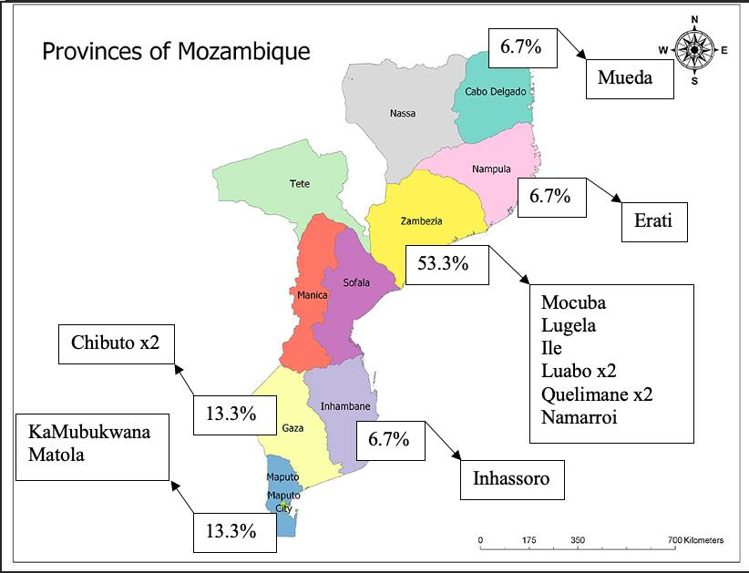
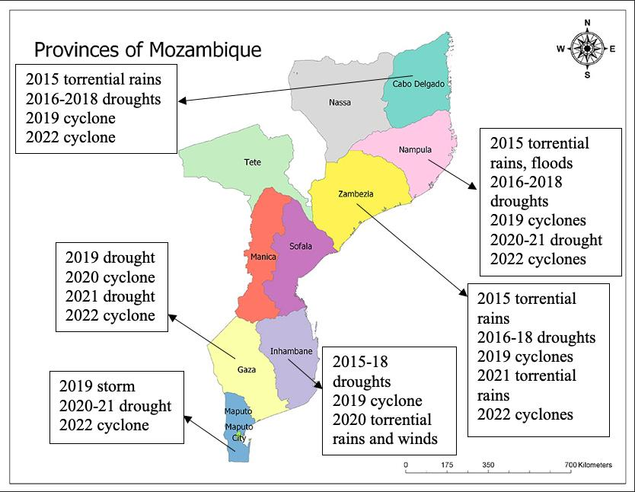
Maps
Respondent locations
Extreme weather reports
Notes:
So far It has been established that infrastructural accessibility, maintenance and security are three major themes needing improvement. acting on these requires more consideration for resilience than ever before. Extreme weather events are increasing in magnitude and frequency due to global climate change, and Mozambique is a country particularly vulnerable because of its location. The two maps on the screen portray the frequency of climatic extremes the schools studied in this research have been experiencing.
Climate change and its consequences are regarded a vulnerability exacerbator, and the current WASH provision in Mozambican schools is already leaving many children vulnerable to harm, disease, and absenteeism, without accounting for the climatic challenges ahead. Without considering and integrating climate resilience in WASH policy, the sustainability of any achievements towards improving school WASH will lack longevity.

Slide 19
The importance of climate resilient WASH: The Statistics
Notes:
The importance of climate resilient WASH: the statistics. As seen on the previous slide, the last impactful extreme weather event experienced by the teachers surveyed either occurred in 2021 or 2022. The next slides demonstrate how it impacted WASH school facilities and services.

Slide 20
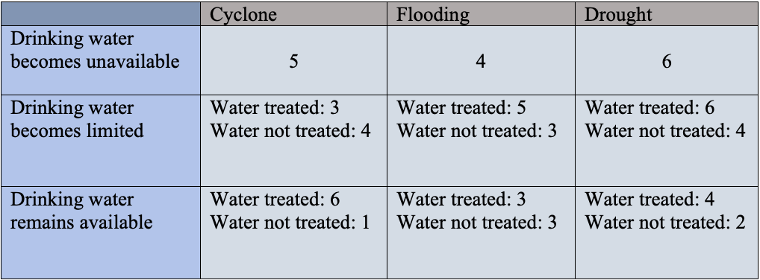
Water
60% said that their water source got damaged, 13% reporting they hadn’t been fixed yet.
Out of all WASH facilities, the most resilient were hand washing facilities, as 93% reported no damage and the 7% that said did have since been fixed.
Table 1. How drinking water was affected depending on event.
Notes:
60% of respondents said their water source got damaged during the last extreme weather event, 13% reporting that it hadn’t been fixed yet. Yet out of all WASH facilities, the most resilient were hand washing facilities, with 93% reporting no damage with the 7% that did report damage declaring they had since been fixed. However, if the hand washing facilities are the drinking water points too (e.g., taps), intact infrastructure does not provide safe WASH if there is no non-contaminated running water. For example, table 1 shows how drinking water would get differently affected depending on the extreme weather event at hand, and if we remember from a few slides back, climate change aside, many teachers are unaware of or lack the resources to treat water under normal circumstances.

Slide 21
Sanitation
Latrine/septic tank emptying
Sanitation facility during an event and the subsequent maintenance
46% said their sanitation facilities had been damaged, 13% reporting they hadn’t been fixed yet.
Notes:
Functioning sanitation facilities during an extreme weather event or in the immediate aftermath of an event are vital preventative measures from humanitarian disaster. For instance, it helps prevent the spread of disease. An important aspect of this is maintenance, such as the emptying of latrines/septic tanks. Yet for 60% of the respondents, theirs still hadn’t been emptied since the last event. However, on a positive note, the number of those reporting unfixed damage to their sanitation facilities from the last event was quite low at 13%.

Slide 22
Hygiene
Menstrual Material Disposal
Menstrual Hygiene Resources
Notes:
Regarding hygiene, extreme weather events can disproportionately affect girls when their access to MHM is drastically reduced due to an event. However as the first pie chart shows, climate change aside, girls are vulnerable in schools due to a lack of disposal options of menstrual materials in the first place. Taking the already scarce menstrual hygiene resources into consideration, half still remained available during the last event or in its aftermath and only became unavailable for 7%. In these circumstances, teaching lessons on how to upkeep safe MHM in the event of an emergency may be resilient practice to reduce female vulnerability to climatic extremes. I imagine this could follow a similar framework as the efforts and lessons to encourage the general population to wash their hands during the Covid-19 pandemic to prevent ill-health and its spread.

Slide 23
Stakeholder consideration
Overall, actively considered.
No mention of climate resilience in OP.
Schools need infrastructural upgrade for resilience, particularly in rural settings.
Infrastructure is only resilient if maintained.
Notes:
Now that I have given an overview of some of the key findings my surveys presented from teacher experiences of extreme weather, I will talk about stakeholder considerations. Although there is a consensus amongst all stakeholders that climate change is a threat to safe schooling, and although it is actively considered in the SEP and recent governmental decree, the country’s school WASH currently remains ill-prepared. The fact that there was no mention of climate resilience in the 2020-2022 OP may be a reason for this as it presents the initial stages of the educational plan for almost the next decade, however this may be because the recent governmental decree on climate change did not come into effect until June of 2022 which expects to be one of the first policy-enforcing decrees of its kind. That being said, there was a general consensus that schools need infrastructural upgrades, particularly in rural settings. However I want to note that infrastructure is only resilient if maintained, and there was generally a lack of clarity on whether plans for new climate resilient infrastructure include a prioritisation of their maintenance.

Slide 24
Stakeholder consideration
Three conclusions from the interviews:
schools are often used in disaster aftermath but are not necessarily classified as official emergency settlements, and so WASH provision under these circumstances do not get planned for
the current infrastructure is therefore unprepared to cope with an influx of new users,
And either:
there is no open communication from ministries with schools over who uses facilities, despite the expectation from ministries for school communication
Or
the wider community usage of vicinities gets disregarded.
Notes:
Three conclusions could be made from the interviews with stakeholders. A) schools are often used in disaster aftermath but are not necessarily classified as official emergency settlements, and so WASH provision under these circumstances do not generally get planned for. B) the current infrastructure is therefore unprepared to cope with an influx of new users, and as already established, are not resourceful enough under normal circumstances to be shared with a wider community. And either c) there is no open communication from ministries with schools over who uses facilities, despite the expectation from ministries for school communication. OR d) the wider community usage of vicinities gets disregarded.

Slide 25
Results
The policy gaps
Notes:
At this stage, it was time to gather my findings and research whether the reason for the challenges I identified were because of a genuine gap in policy, or if the problem lied elsewhere.

Slide 26
Policy methodological context refresher
Identified type one and type two policy gaps from comparing governmental documents to hypothesised policy gaps from findings.
Type one policy gap:
there is no existing policy on the matter
Type two policy gap:
there is a gap between formulation and implementation
The documents used to analyse policy were the Strategic Education Plan (SEP) 2020-29 and the Operational Plan (OP) 2020-22
Notes:
But first, as this is the part of my research which is probably the most relevant to you, I will give a little refresher of the methodology. I identified type one and type two policy gaps from comparing governmental documents to my own hypothesised policy gaps derived from my findings for aims 1 and 2. A type one policy gap means there is no existing policy on the matter, and a type two policy gap means that although there is policy on the matter, there is a gap between its formulation and its implementation. The documents used to analyse policy were the SEP and the OP.

Slide 27
Type one policy gaps
I found no policy addressing the following:
Improving the toilet:student ratio.
Allocating responsibility or a separate budget to maintenance which has a specific allocation for WASH.
Providing resources such as water treatment tablets, soap or locks.
Teacher WASH facilities.
Notes:
Starting with type one policy gaps, I found no policy addressing the toilet:student ratio, clear responsibility or budget allocation for WASH maintenance, WASH resource provision, teacher facilities

Slide 28
Type one policy gaps (continued)
Introducing Health Clubs into the curriculum which includes taught MHM to all, with additional lessons on climate resilient WASH practices.
Teacher training on safe WASH identification.
Recognising, monitoring or considering the use of WASH facilities by wider communities.
Policy which officially considers schools as formal emergency settlements.
Policy in the initial stages of the SEP that sufficiently addresses female-friendly and disability-friendly WASH from the initial implementation of the SEP.
Notes:
Health clubs which include menstrual hygiene management and climate resilient practices, WASH teacher training, community interaction with school WASH, the consideration of schools as emergency settlements, and policy in the initial stages which sufficiently addresses female-friendly and disability-friendly WASH from the initial implementation stages of the SEP.

Slide 29
Type two policy gaps
I found there was a gap between policy formulation and implementation on the following areas:
Improving WASH facilities infrastructurally
Addressing geographic disparities in resource allocation to make improvements
WASH facility maintenance
The provision of emergency WASH in schools
The improvement of WASH facilities which addresses intersectional needs
Notes:
In terms of type two policy gaps, I found there was a gap between policy formulation and implementation on the following areas:
Improving WASH facilities infrastructurally
Addressing geographic disparities in resource allocation to make improvements
WASH facility maintenance
The provision of emergency WASH in schools
The improvement of WASH facilities which addresses intersectional needs

Slide 30
If there is a barrier between policy formulation and implementation, then maybe law is required instead.
Notes:
Despite the type one and type two policy gaps, it became very clear that there was a general awareness by stakeholders of the areas that require improvement. For example, the topic of climate resilience, and WASH facility accessibility to intersectional needs were both very important to all stakeholders and teachers. However, a common barrier mentioned to fixing these problems were a lack of resources and finances. Yet more money does not necessarily translate to improvements: who, what, why and how money is invested into school WASH will significantly impact whether interventions are helpful or not. And so, after researching the influence of donor investments I reached the conclusion that there is either a gap in policy or law which allocates more control to ministries over how donor investments are spent; or there requires better aids for donors to understand where their investments are needed, to improve conceptualisation of their influence and to avoid maladaptation.

Slide 31
Policy recommendations: where to fill the gaps
Notes:
And so, this leaves us to my final point of my research. Now that I have given you all a lot of information, where does this leave us in terms of recommendations?

Slide 32

There needs to be policy enforcing the distribution of resources which significantly differentiate between safe and unsafe WASH, key resource examples being soap, water treatment tablets and locks for doors.
Policy requires establishing that recognises and enforces the equal prioritisation of teacher WASH needs.
There needs to be policy enforcing an official curriculum for Health Clubs which includes educational WASH practices for students and teachers.
The existing policy that recognises the intersectional requirements of WASH facilities needs implementing from the design phase and from the early stages of the SEP transition.
Notes:
This slide outlines the areas I believe we could fill the gaps in policy, in regard to:
1. Enforcing equal distribution of resources
2. Enforcing the equal prioritisation of teacher WASH needs
3. Health Clubs
4. Early establishment of accessible WASH

Slide 33

Clear policy is required for integrating teaching climate resilient WASH practices, uniformly distributed climate resilient WASH facilities, and maintenance of climate resilient infrastructure.
Policy tackling geographic disparities in WASH interventions needs implementing, particularly in applying climate resilient WASH as different locations translate to different experiences. Rural-Urban disparities will exacerbate this.
Adherence to the WHO’s toilet:student ratios require policy establishment and implementation.
Maintenance needs its own budget and policy is required to dictate and enforce clear allocation of responsibility.
Notes:
5. Climate resilient WASH
6. Geographic disparities
7. toilet:student ratios
8. Maintenance of WASH facilities

Slide 34
Conclusions
The teacher experiences do not portray that:
WASH needs are recognised at the macro-level as they truly are
climate resilience is actively considered for new education and WASH interventions
There are policy gaps which require addressing
The barriers between policy formulation and implementation suggest that if policy cannot be enforced, laws may be required instead
Overall, Mozambique shows to be a proactive country.
Notes:
Not all areas in need of improvement regarding WASH facilities and practices in schools go unnoticed by those who have the power to change them. BUT the teacher experiences do not portray that: 1. WASH needs are recognised at the macro-level as they truly are; 2. climate resilience is actively considered for new education and WASH interventions.
There are policy gaps which require addressing and the barriers between policy formulation and implementation suggest that if policy cannot be enforced, laws may be required instead. The barriers to achieving safe WASH in schools require regular evaluation and problem-solving, as much as the goals and targets do too.
But overall, Mozambique shows to be a proactive country in trying to address many of its developmental challenges, and there is clearly much enthusiasm to do so. This is not an easy or straight-forward task.

Slide 35
Acknowledgements
Notes:
Now that my presentation has come to an end, I just wanted to say a big thank you to everyone who has participated in this research and made this possible. Especially the WaterAid Mozambique team and WaterAid UK, thank you for giving me the opportunity to do this presentation. It has become very clear to me and it has been really inspiring to see how important this topic is regarded amongst stakeholders. Although there are a few challenges ahead, when I look at the history of the nation as context, overcoming the barriers to sustainable development appears to be no insuperable challenge. I really hope that my research is of some use to you and hopefully makes a little bit of a difference somewhere in our collective pursuit for improved schools for the children and teachers of Mozambique, as well as for the climate resilience of the nation.

Slide 36
Obrigado Pelo Seu Tempo
Any questions are welcome!

